Slide 1


Slide 2
MongoDB
No SQL
Document Based
Open source
Cross Platform
Stores data in binary format
Handles large sets of distributed data

Slide 3
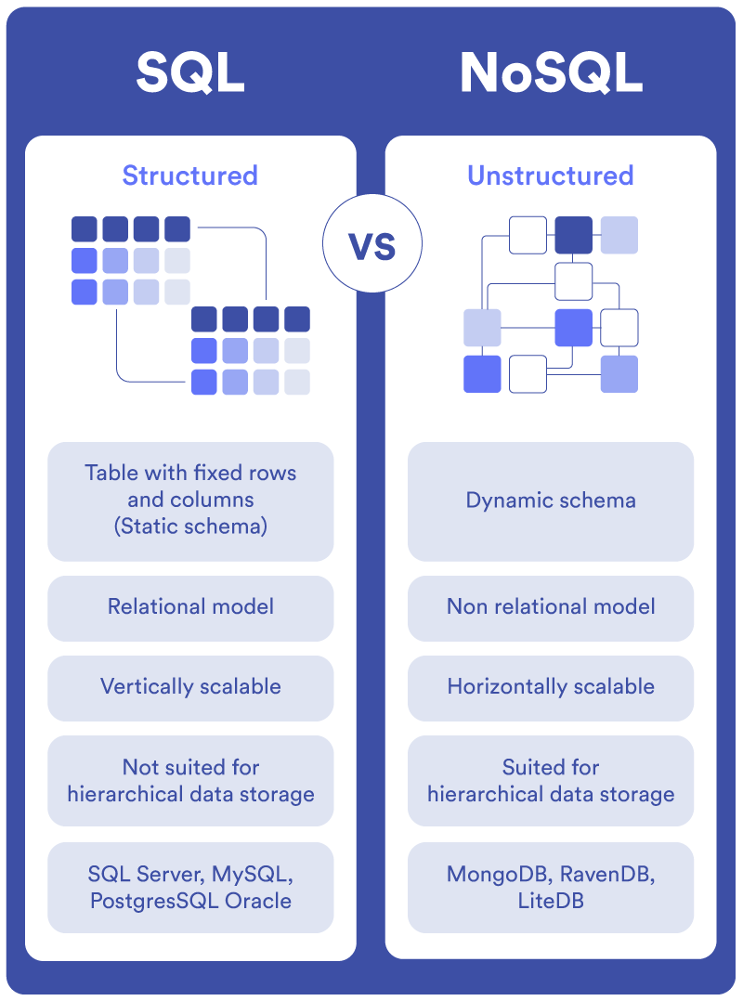

Slide 4
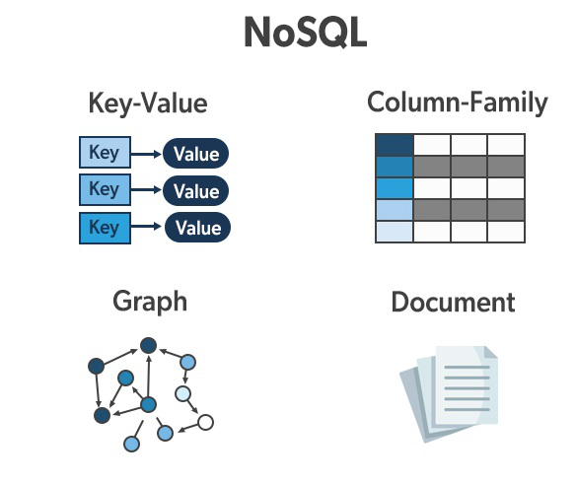

Slide 5
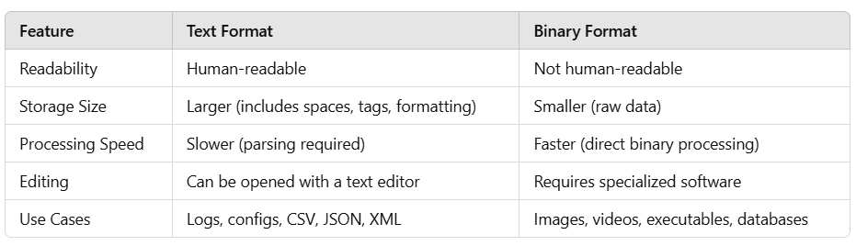

MongoDB

Slide 6
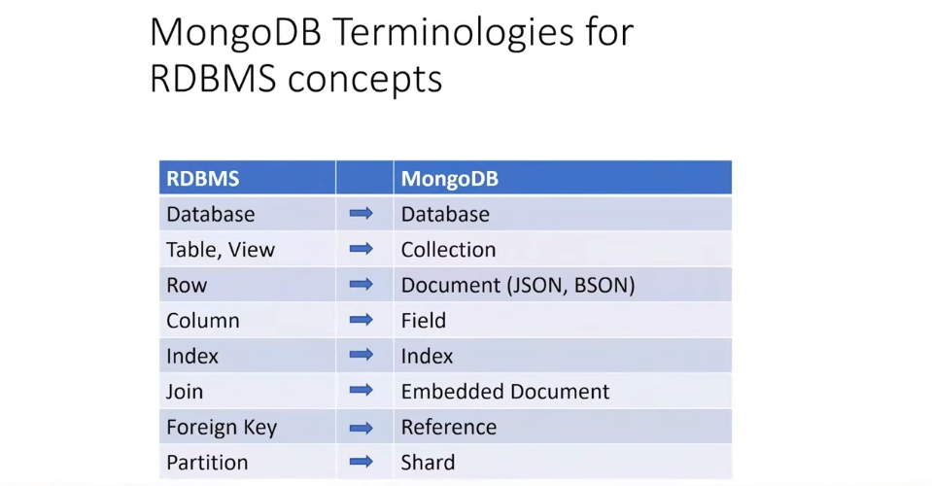

Slide 7
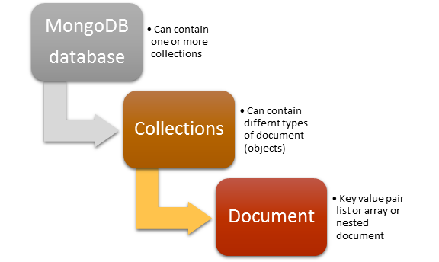

Slide 8
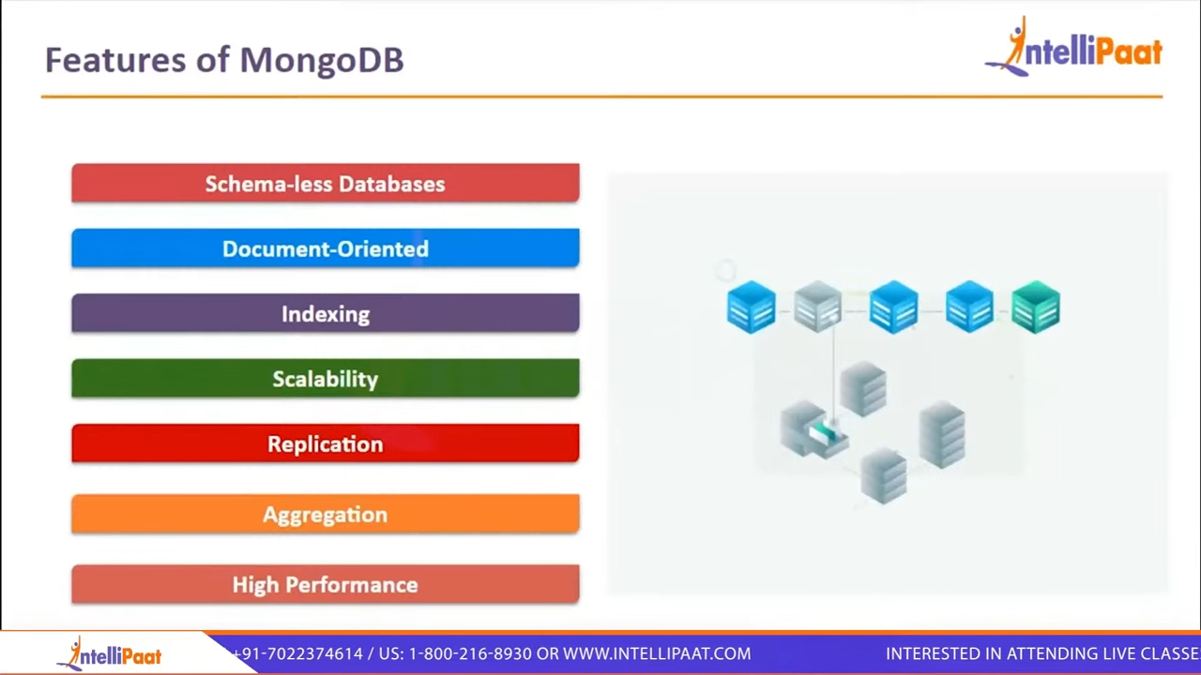

Slide 9

CRUD Operations

Slide 10
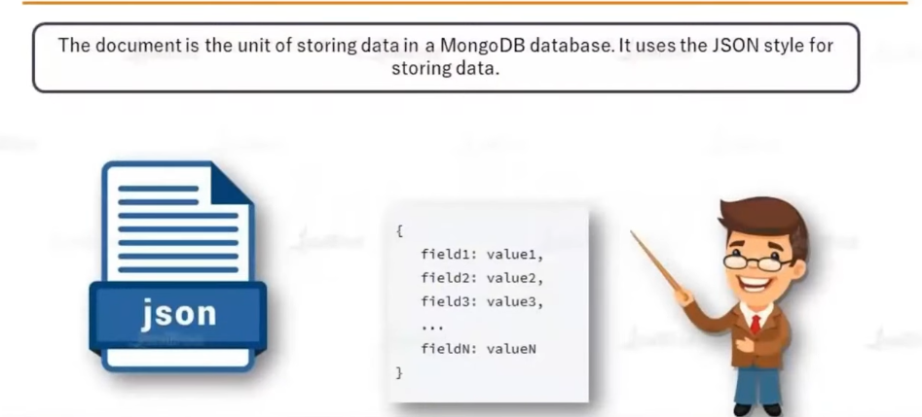
Document

Slide 11
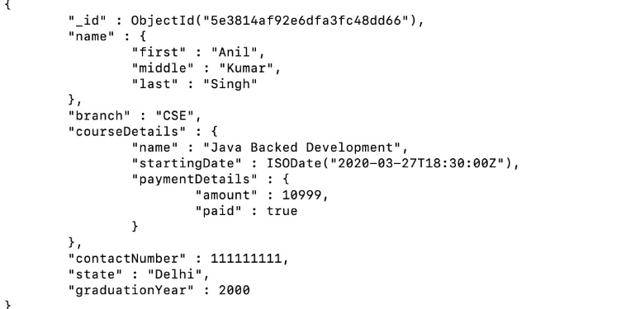
Nested Document

Slide 12
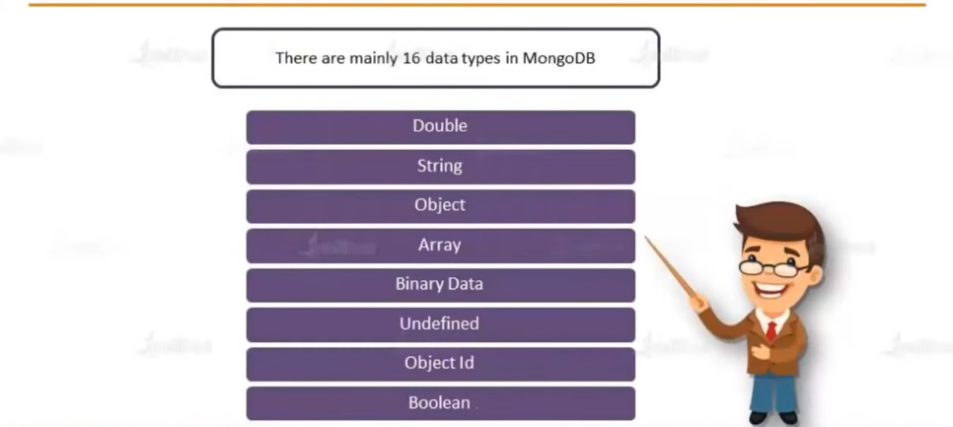
MongoDB Data Types

Slide 13

MongoDB Data Types

Slide 14
MongoDB’s Applications
1. E-commerce Platforms:
Product Catalogs: MongoDB's flexible schema allows for storing diverse product information, including attributes, images, and variations.
User Profiles: Storing user data, including purchase history, preferences, and cart contents.
Real-time Analytics: Tracking user behavior, sales trends, and inventory levels.
2. Content Management Systems (CMS):
Storing Content: Managing articles, blog posts, images, and videos.
User-Generated Content: Handling comments, reviews, and social media feeds.
Dynamic Content Delivery: MongoDB's flexibility enables efficient content updates and personalization.

Slide 15
MongoDB’s Applications
3. Real-time Analytics and Big Data:
Log Data: Storing and analyzing large volumes of log data from web servers and applications.
Sensor Data: Processing and storing data from IoT devices and sensors.
Social Media Analytics: Tracking user engagement and sentiment analysis.
4. Gaming Applications:
User Profiles: Storing player data, inventory, and game progress.
Leaderboards: Displaying high scores and rankings.
Real-time Game Data: Handling in-game events and interactions.

Slide 16
MongoDB’s Applications
5. Mobile Applications:
Offline Data Storage: Storing data locally on mobile devices for offline access.
User Data Synchronization: Synchronizing data between mobile devices and the server.
Push Notifications: Managing push notifications and user preferences.

Slide 17
MongoDB’s Applications
6. Other Applications:
Geospatial Data: Storing and querying location-based data, such as maps and GPS coordinates.
Customer Analytics: Analyzing customer behavior and preferences.
IoT Applications: Handling data from connected devices and sensors.
Ad Hoc Queries: MongoDB's flexible schema and query language allow for dynamic and complex queries.
Sharding and Replication: MongoDB's sharding and replication features enable high availability and scalability.
Document Model: MongoDB uses a document-based data model, which is well-suited for modern programming languages and helps developers work faster.

Slide 18
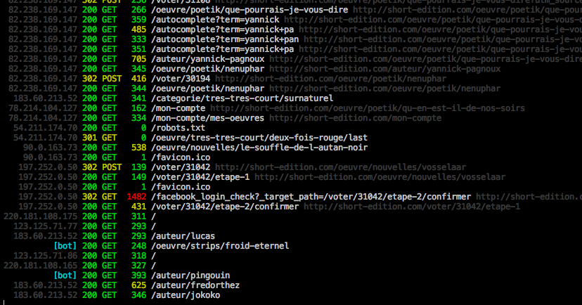
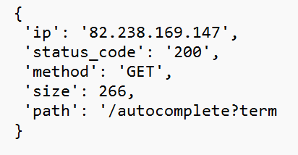
Apache access.log

Slide 19

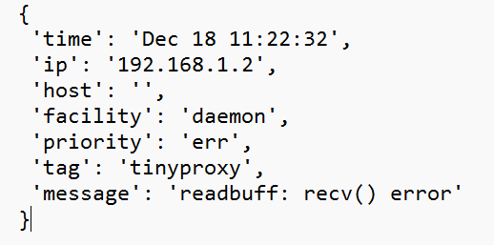
System Logs

Slide 20
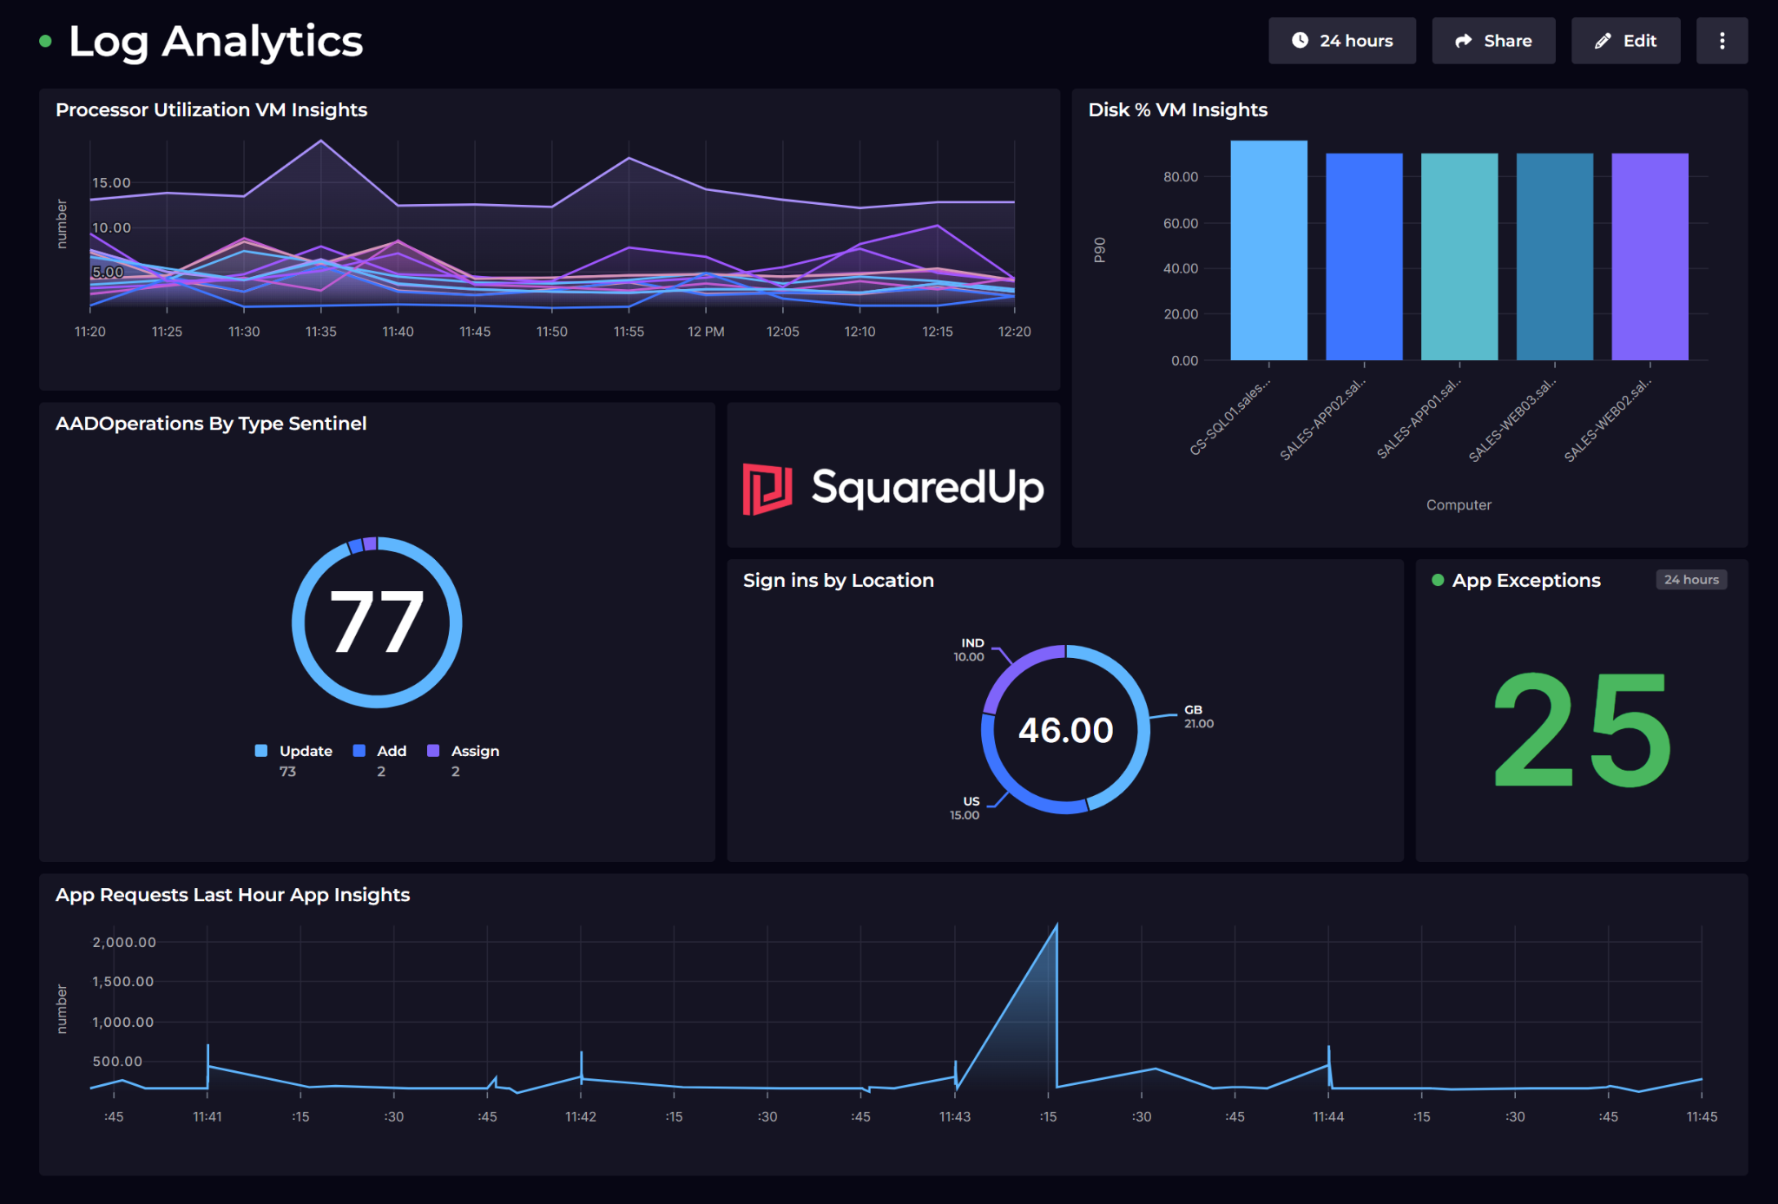
Log Analytics

Slide 21

Scaling

Slide 22
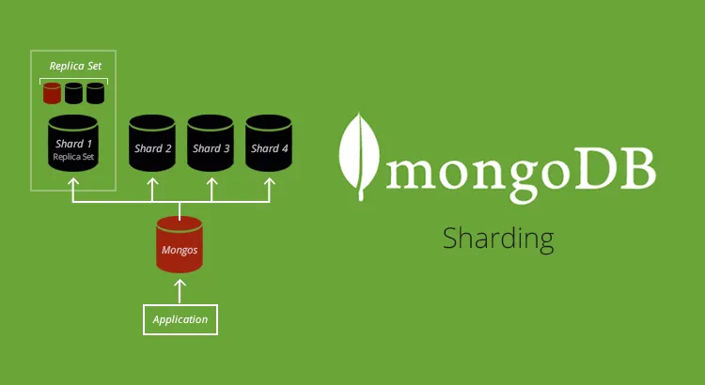
Sharding

Slide 23
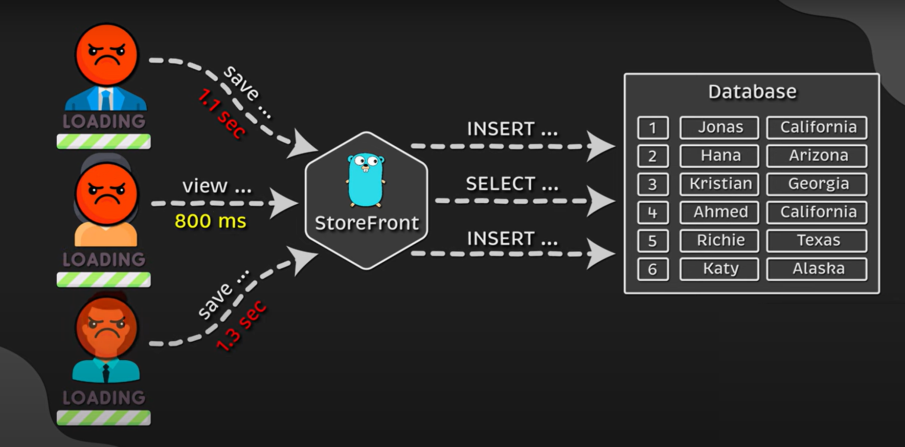
Database Sharding

Slide 24
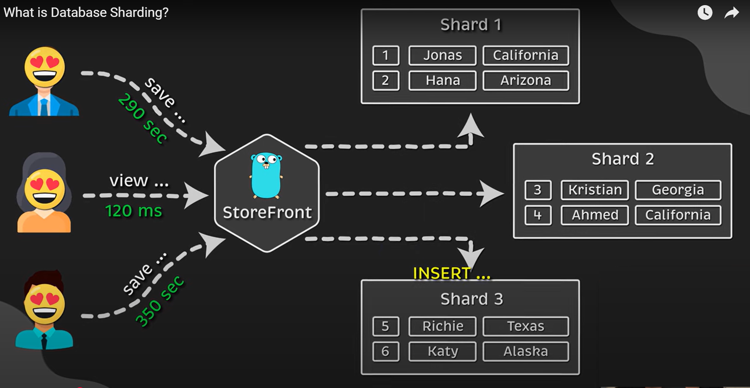

Slide 25
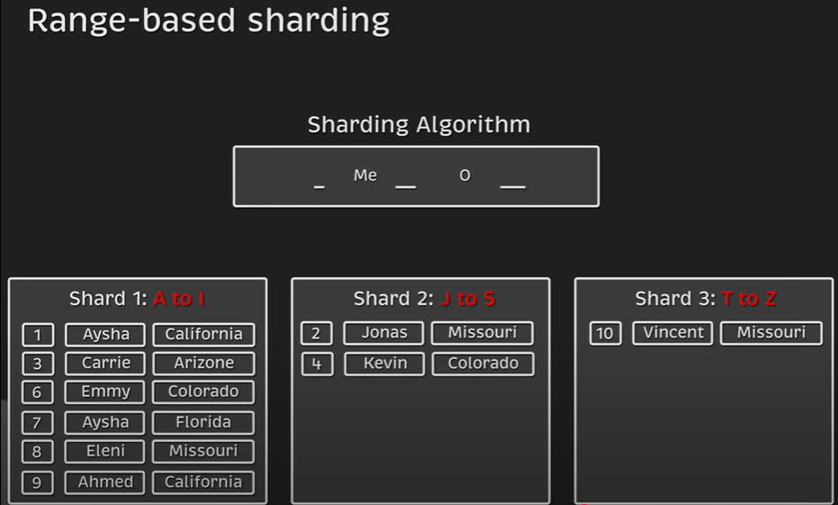

Slide 26
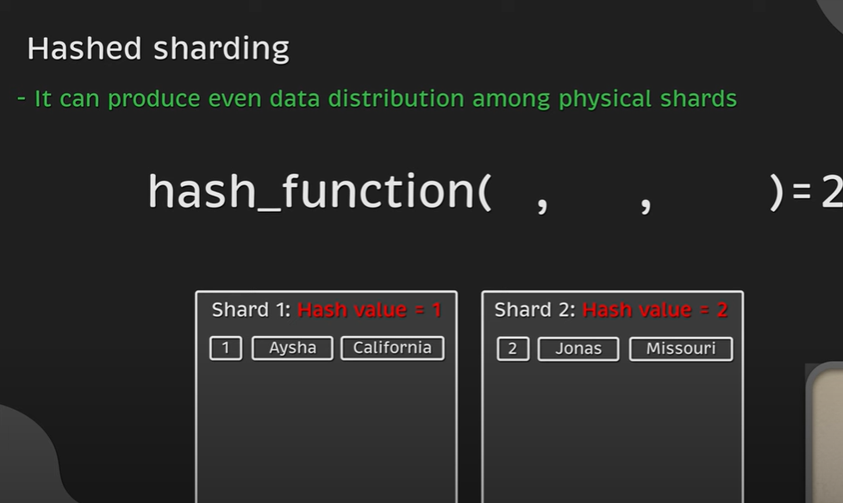

Slide 27
